Slide 1
5 selfish reasons to work reproducibly
More publications, more grants, more awesome!

Slide 2
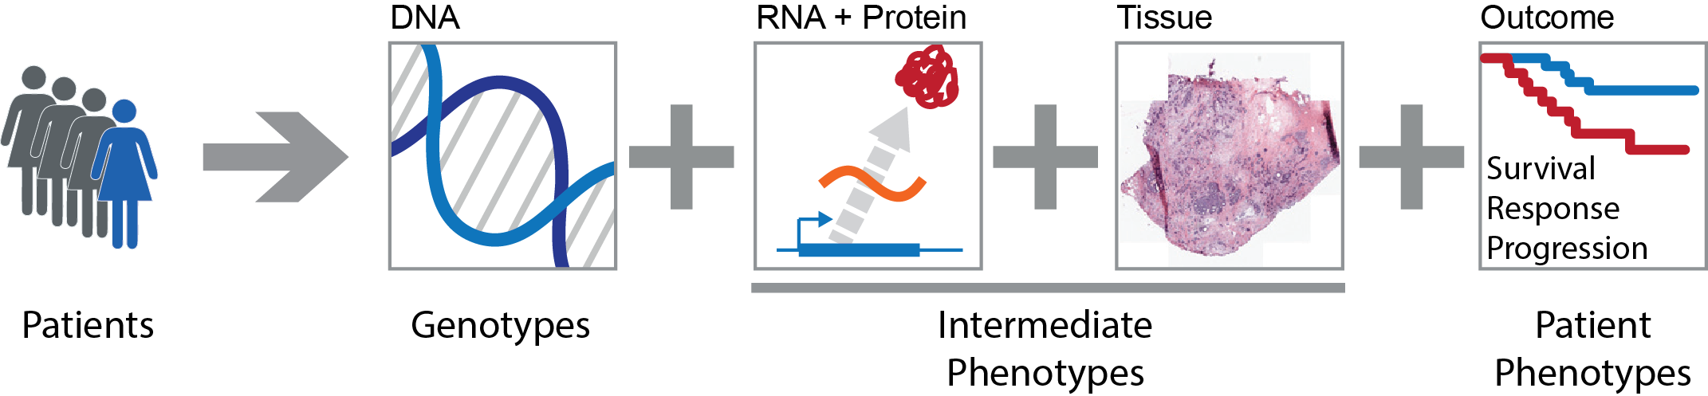
Systems Genetics of Cancer
Genetic variation
In people
In tumours
In clones
Phenotypic variation
Tumour subtypes
Aggressiveness
Survival

Slide 3
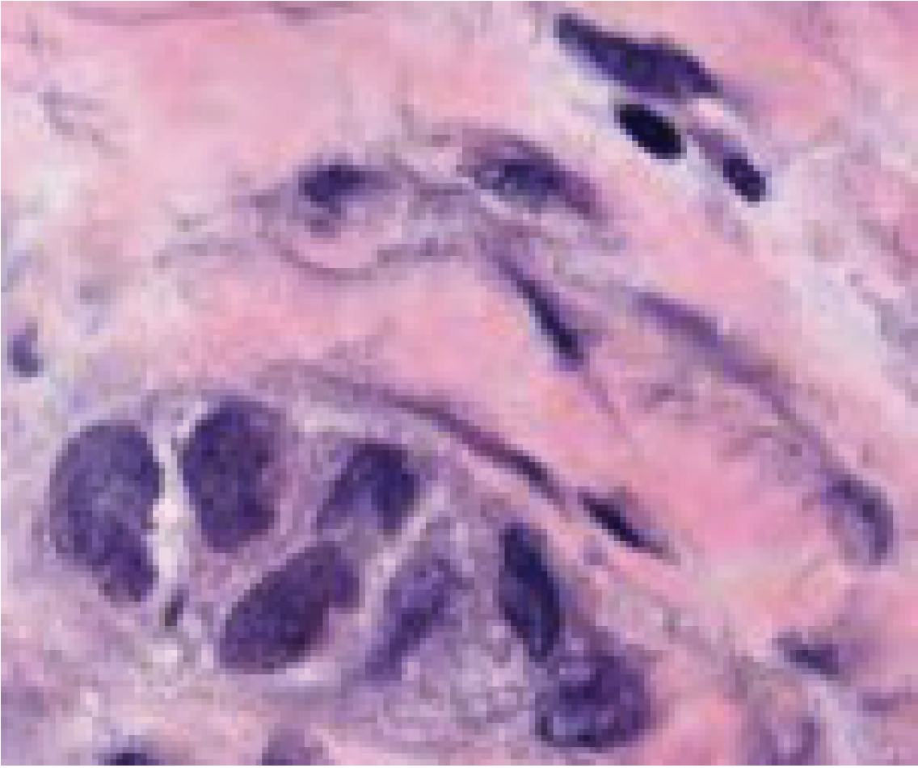

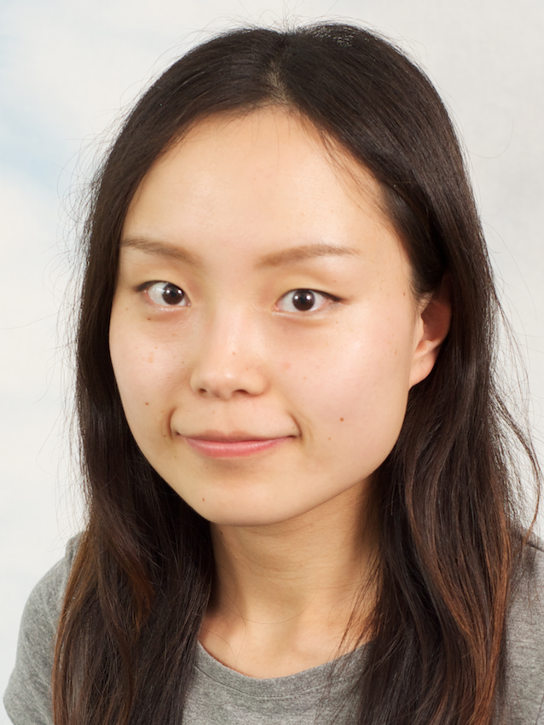
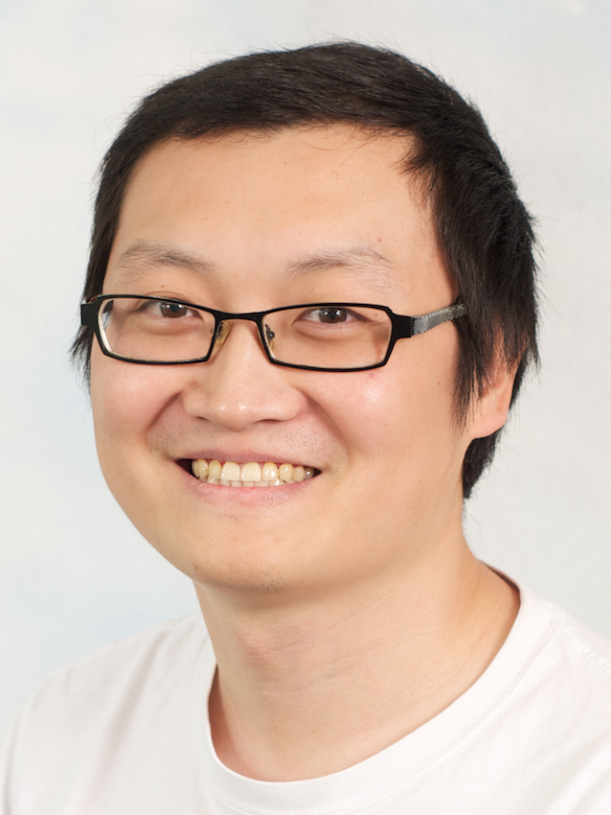
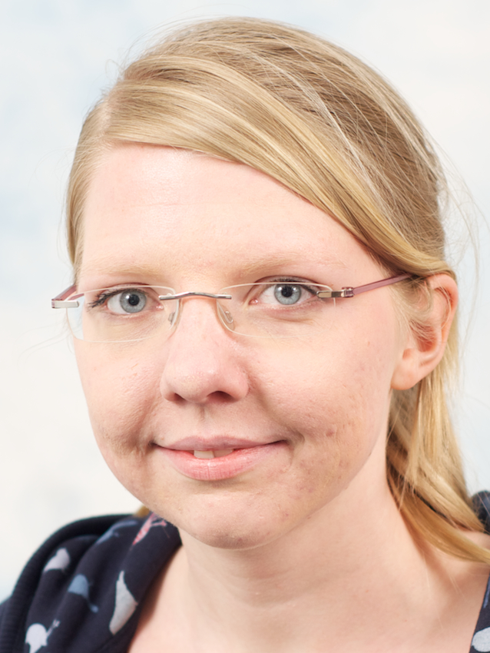
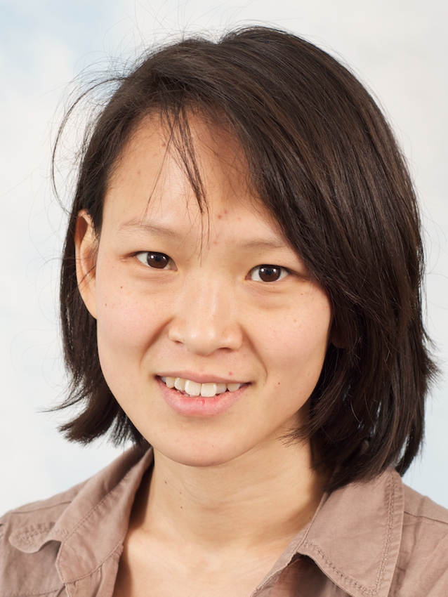

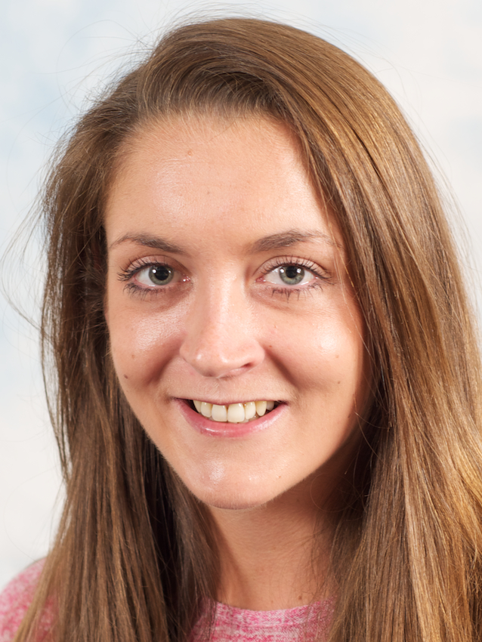
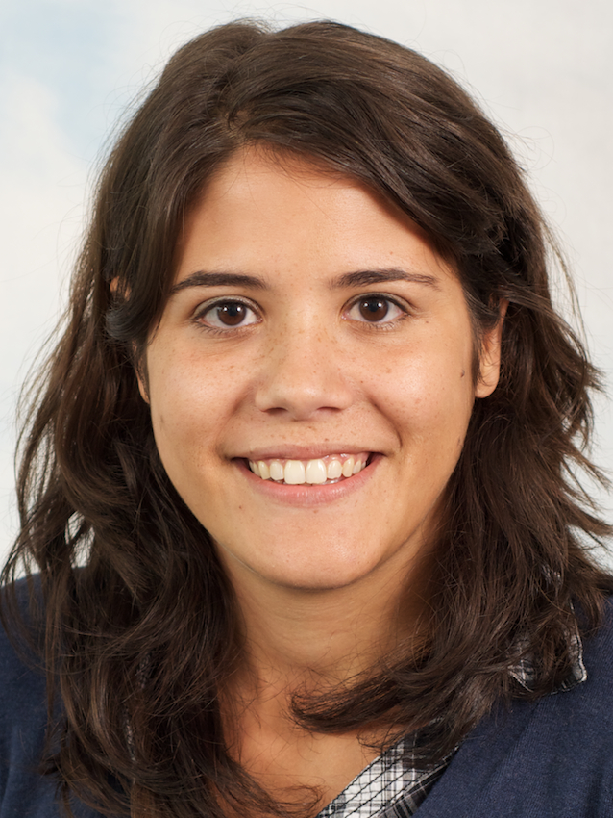


Cancer genome
Function
Cancer genome
Evolution
Cancer tissue
Context
Andy
Wei
Ke
Edith
Anne
Joe
Amanda
Ines
Geoff
Leon

Slide 4
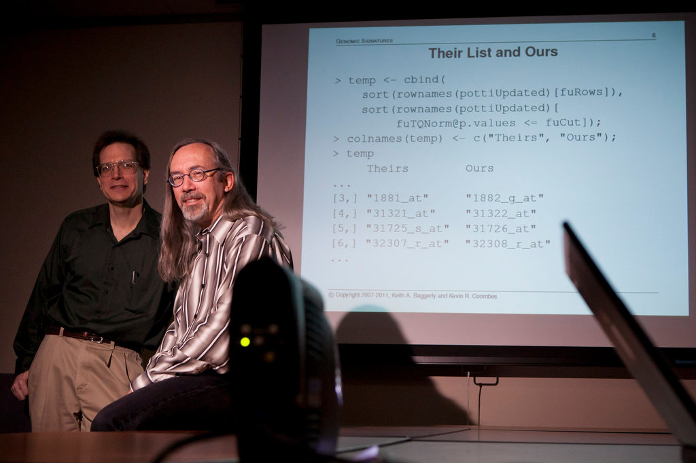
“How Bright Promise in Cancer Testing Fell Apart” New York Times, July 7, 2011

Slide 5
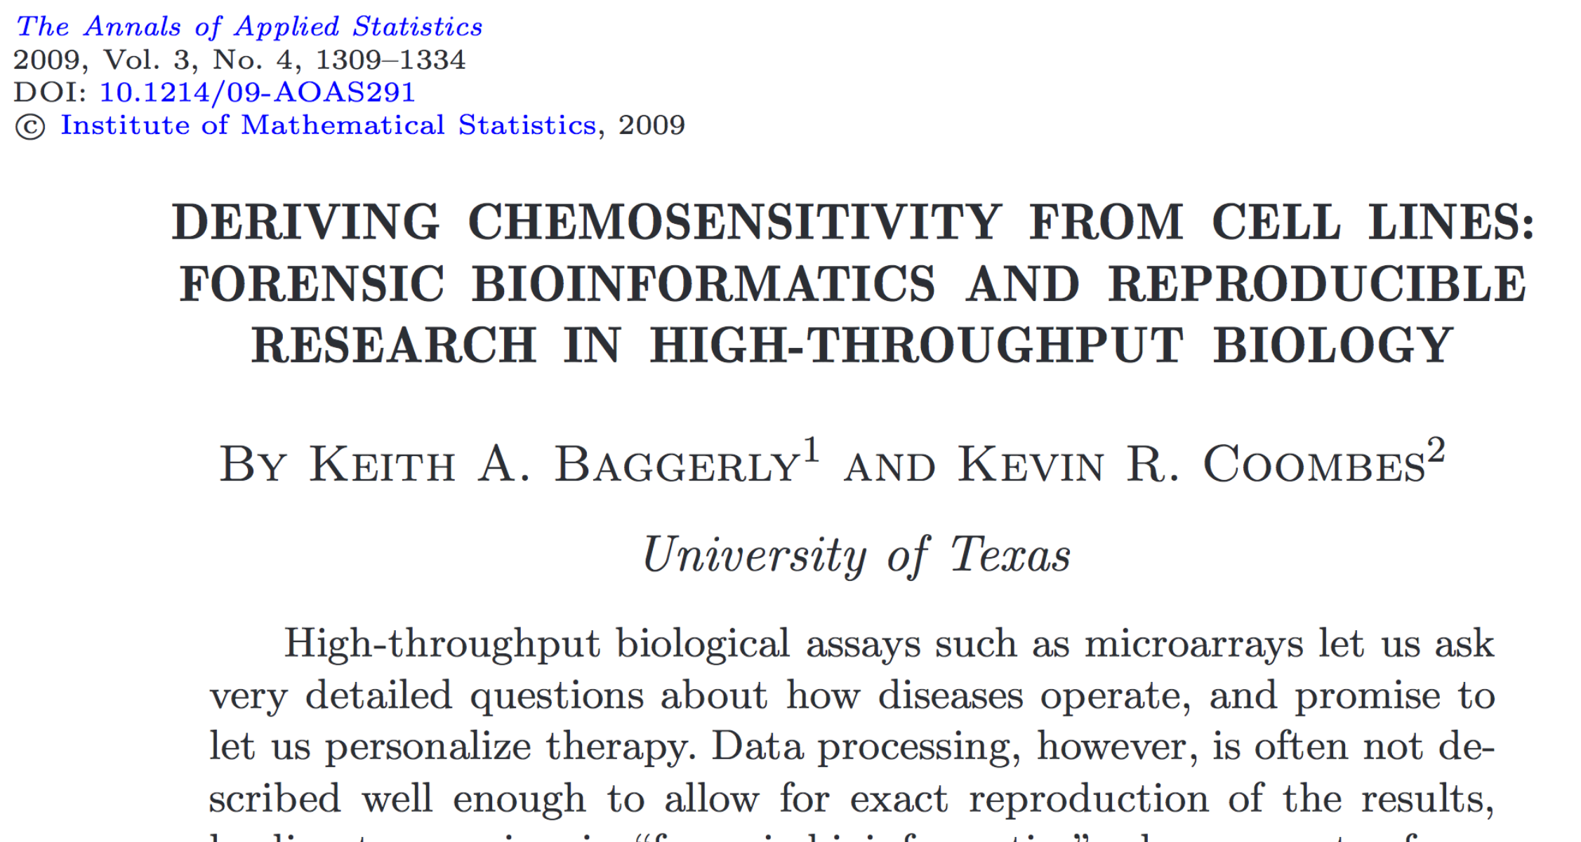

Slide 6
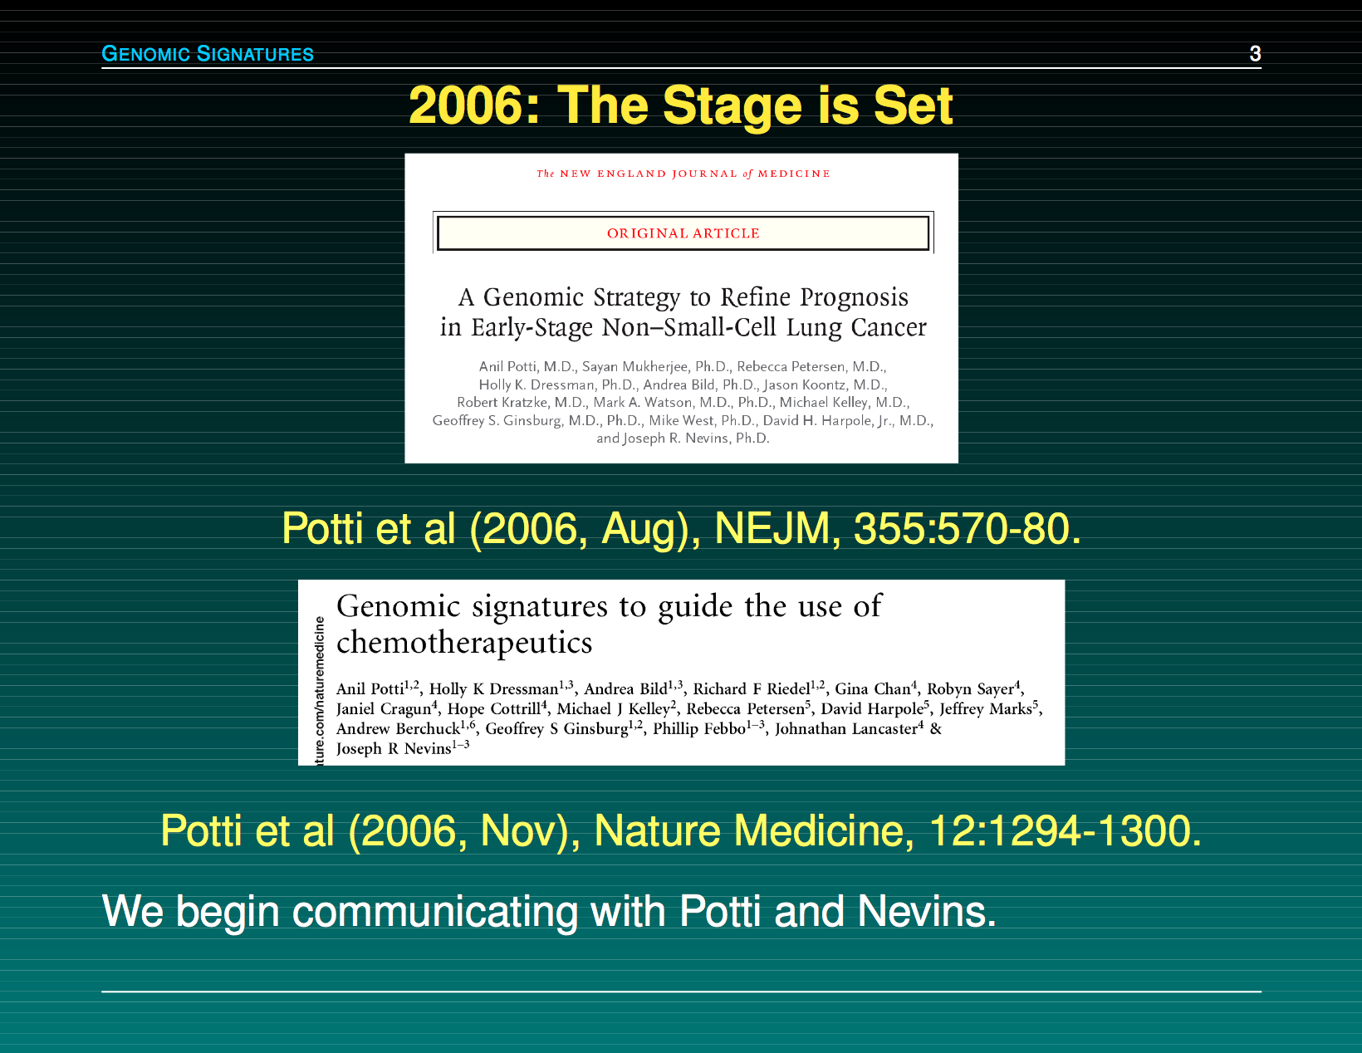

Slide 7
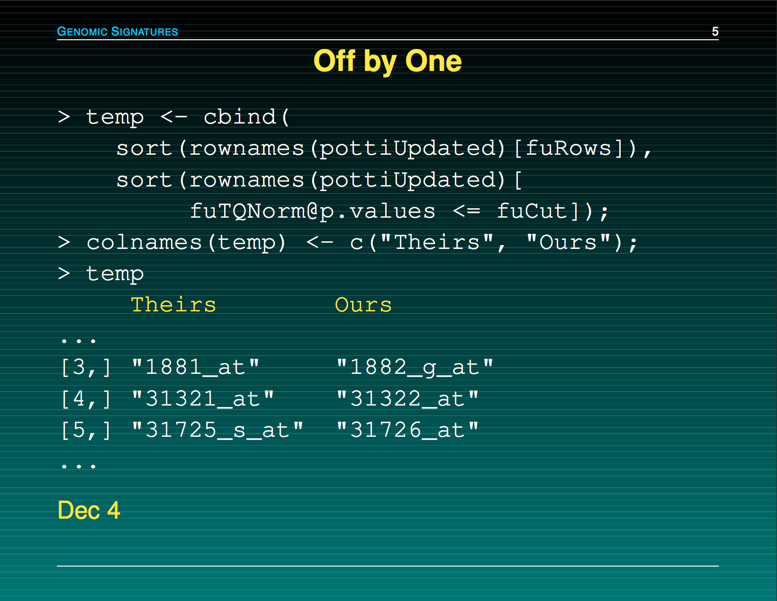
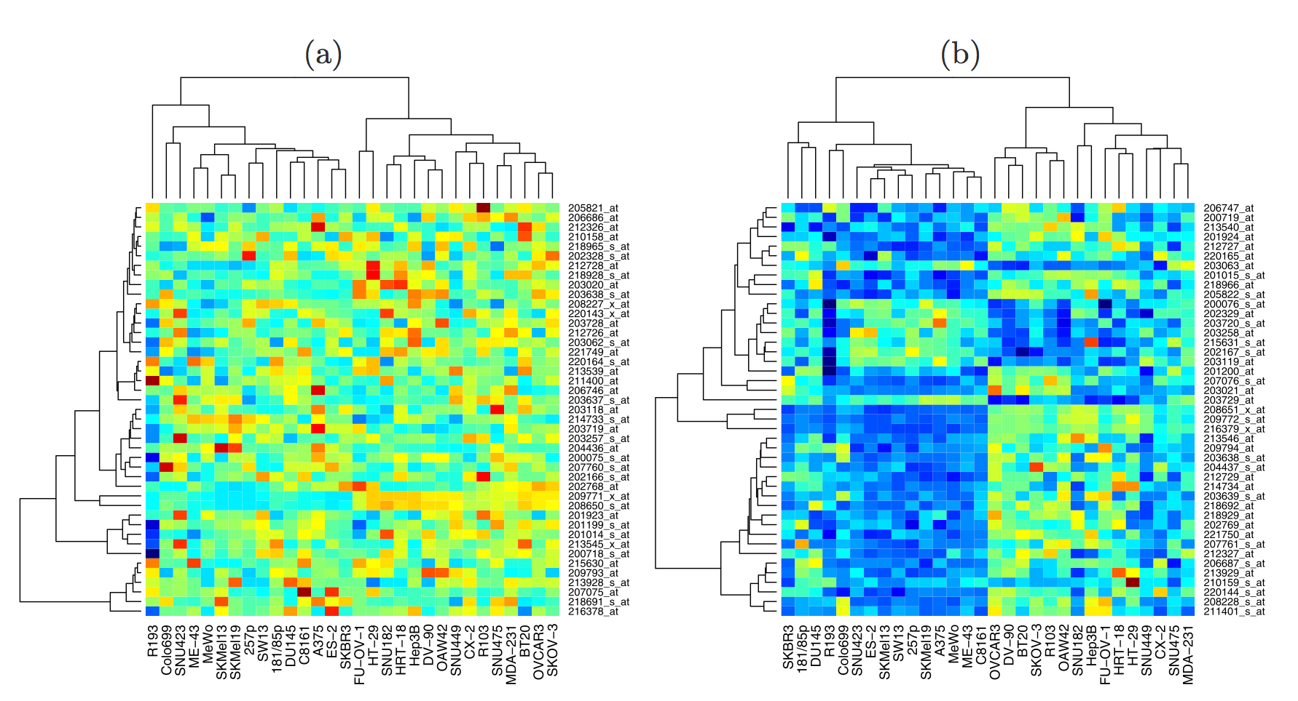

Slide 8
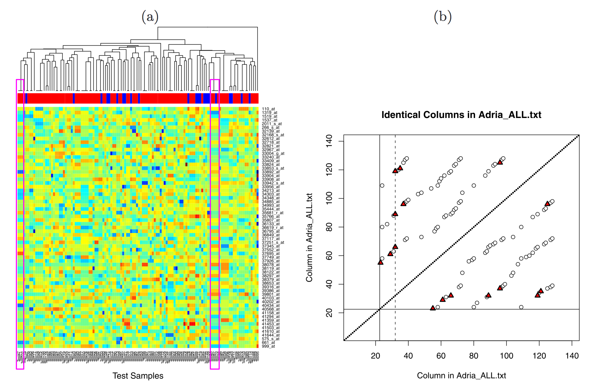
Baggerly & Coombes, AOAS 2009

Slide 9
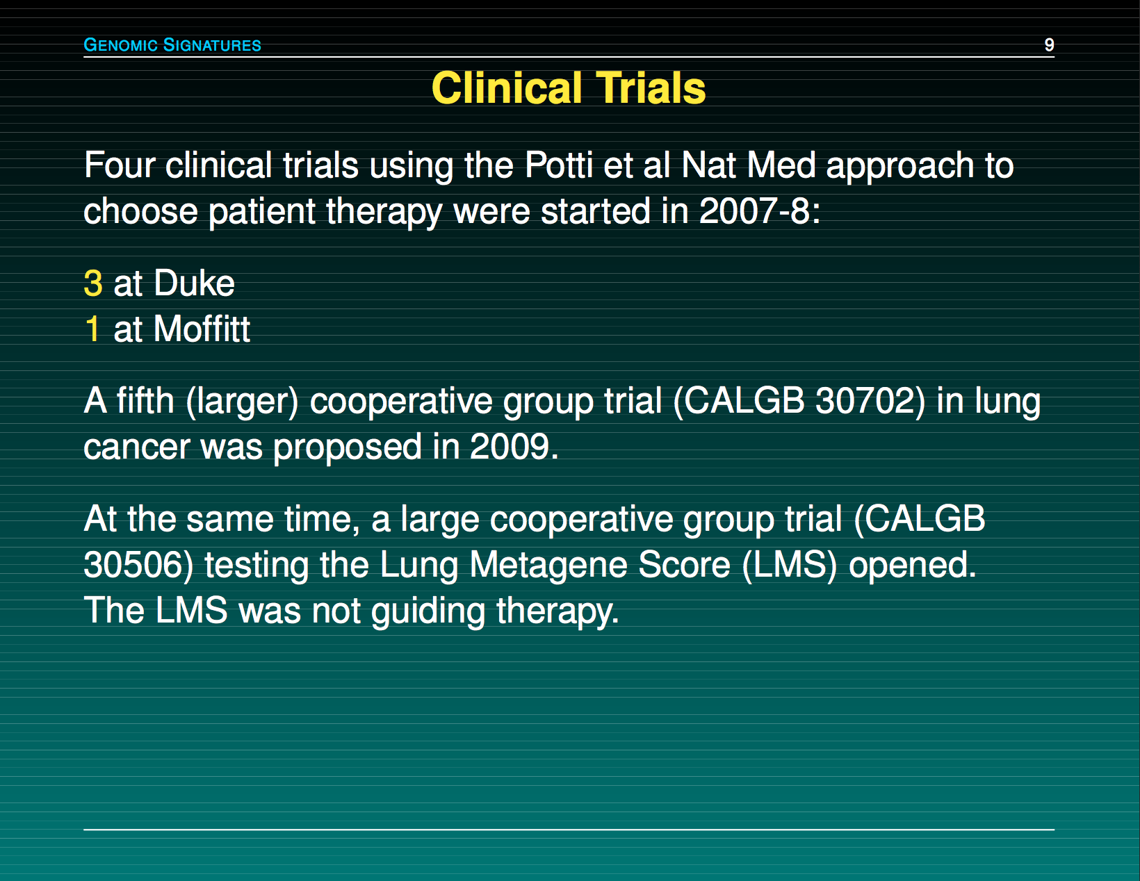

Slide 10
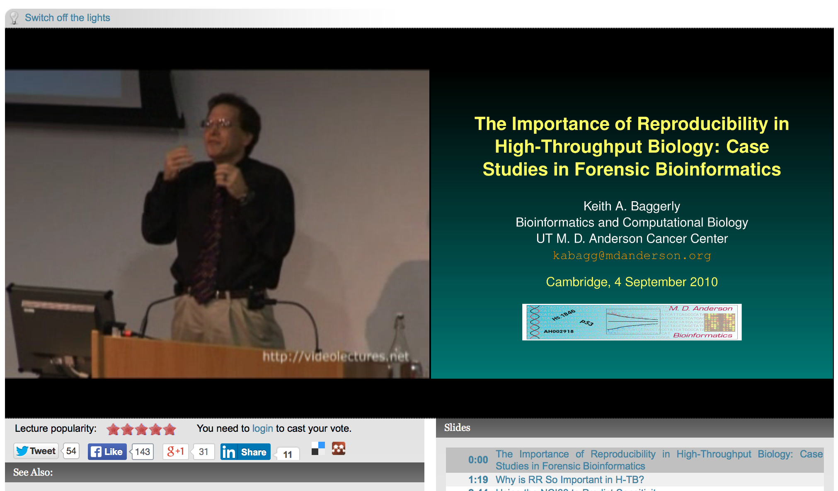
http://videolectures.net/cancerbioinformatics2010_baggerly_irrh/

Slide 11
Reproducibility
0
It’s the right thing to do!
The world would be a better place if everyone did it!
It’s the foundation of Science!
It’s the honourable thing to do!

Slide 12


Slide 13


Slide 14
Reproducibility helps to avoid disaster
1

Slide 15
Anatomy of the NFκB pathway
Step 1
?
Hits
Weak
Phenotype
Strong
NFκB
Step 2
Knock-down
Compare
expression
phenotypes
by NEMs
Known pathway
members
New RNAi Hits

Slide 16
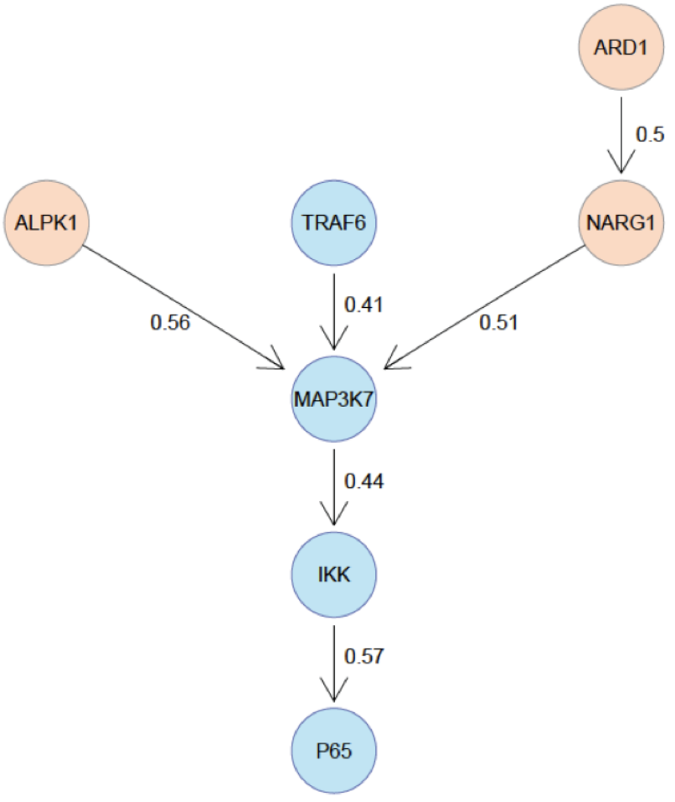
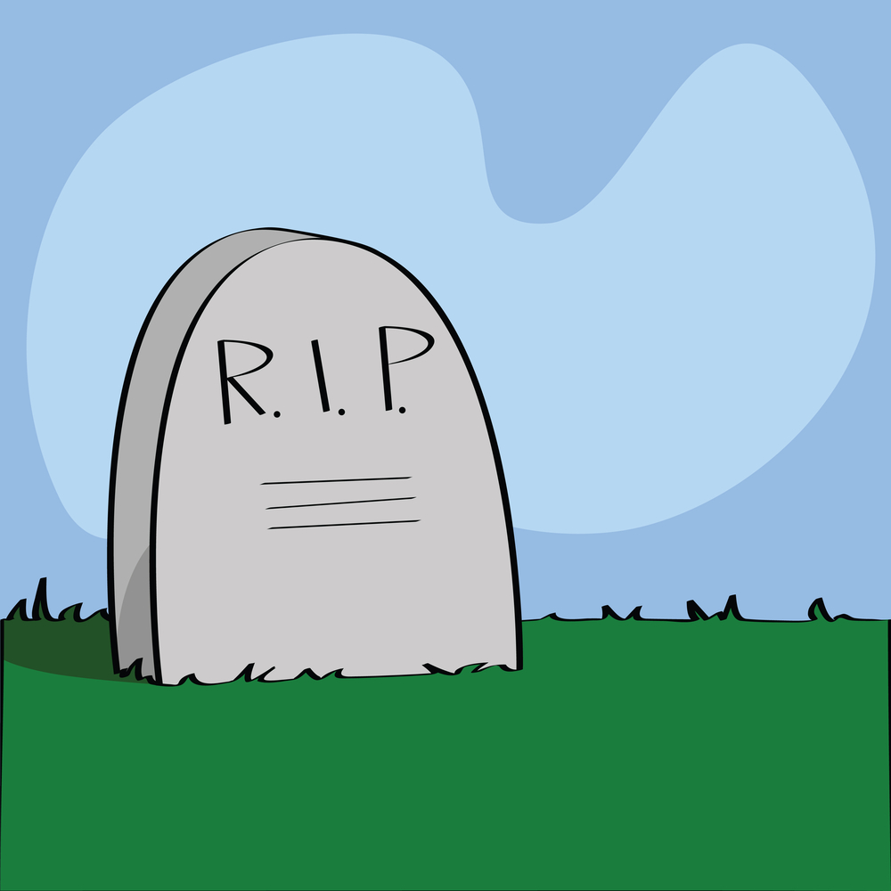
What a nice result!

Slide 17
A project is more
than a beautiful result!

Slide 18
Reproducibility helps writing papers
2

Slide 19
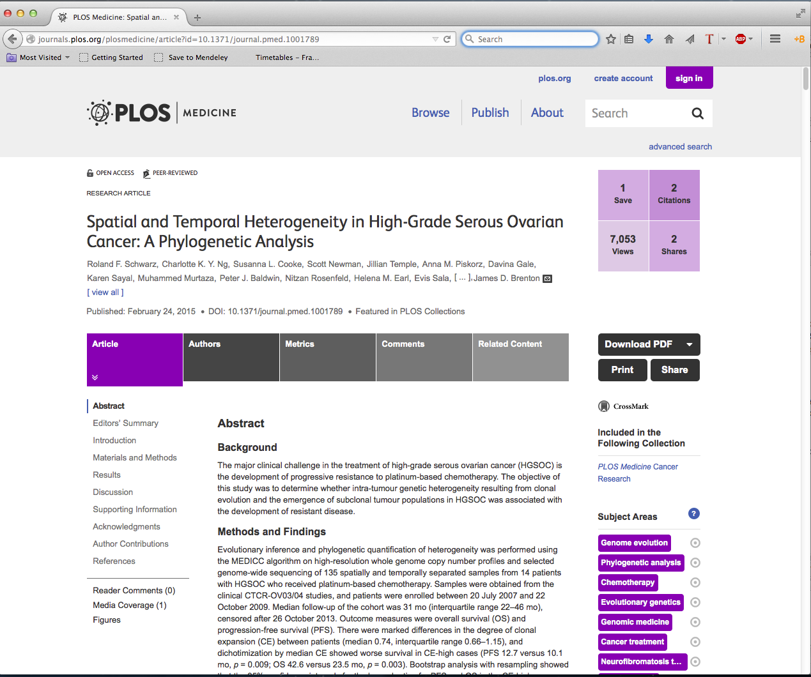
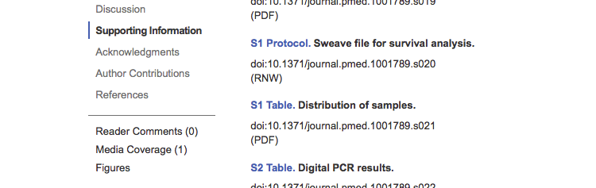

Slide 20
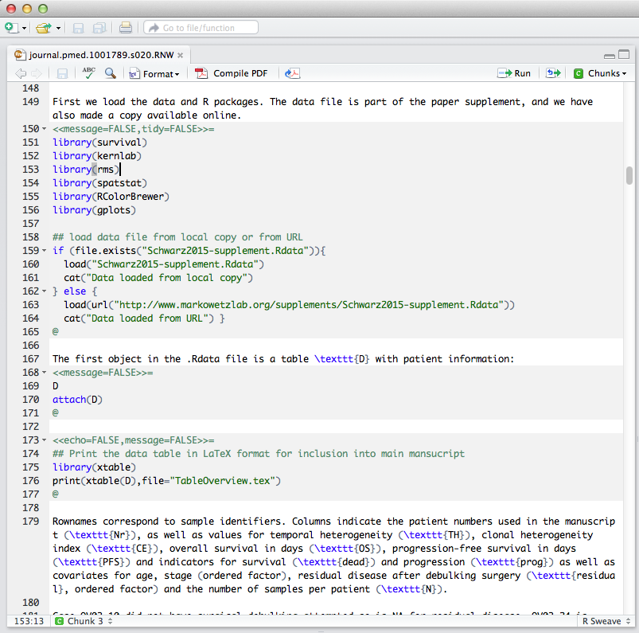
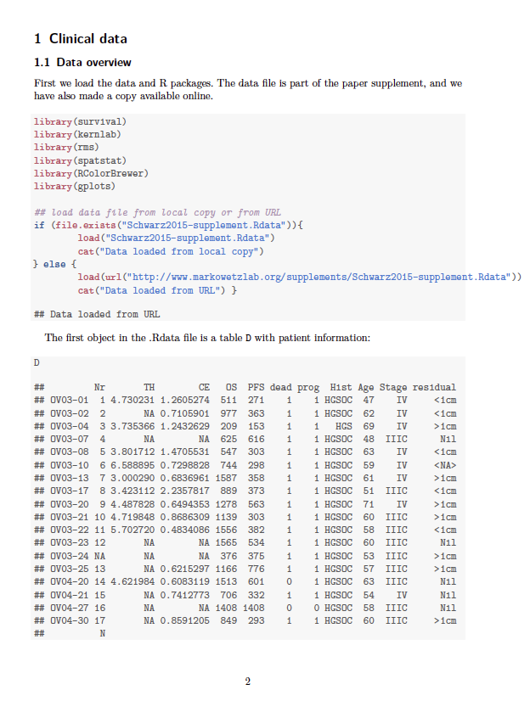

Slide 21
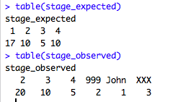
Why is well-documented and easily accessible code+data useful?
Easy to look up numbers and put them in manuscript
Numbers and result automatically update when data change.
It is engaging and more eyes can look over the analysis.

Slide 22
Reproducibility helps arguing with reviewers
3

Slide 23
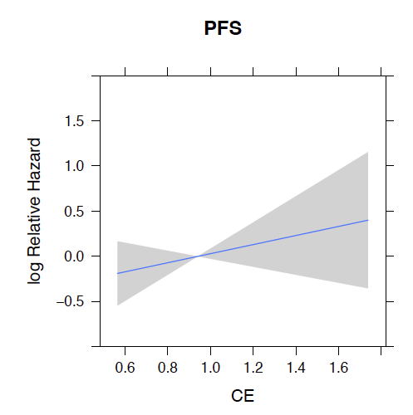
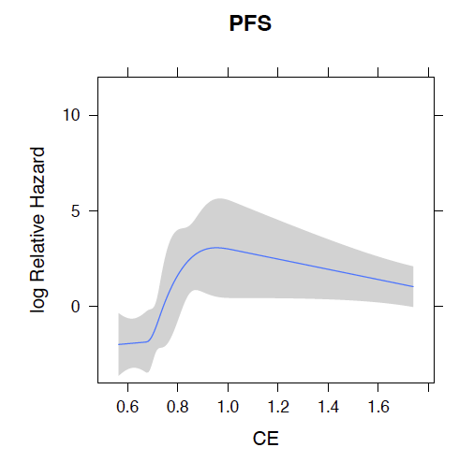
A very engaged reviewer
Reviewer: “I downloaded the authors’ data and tried out a variation of their analysis which gave an insignificant result”
We: “Thank you, the reason is …. and if you do … everything is fine.”

Slide 24
Reproducibility enables continuity
4

Slide 25
“I am so busy,
I can’t remember all the details of all my projects”

Slide 26
“I did this analysis 6 months ago.
Of course I can’t remember all the details any more …”

Slide 27
“My PI said I should continue the project of a previous postdoc.
But that postdoc is long gone and hasn’t saved any scripts or data.”

Slide 28
Reproducibility increases your standing in the community
5

Slide 29
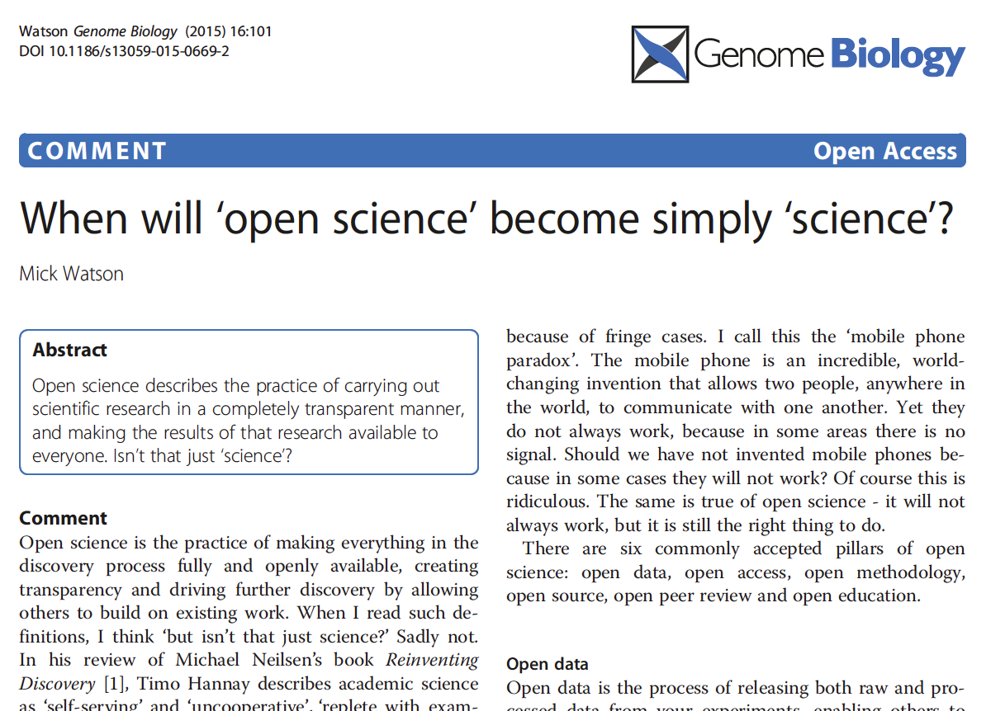

Slide 30
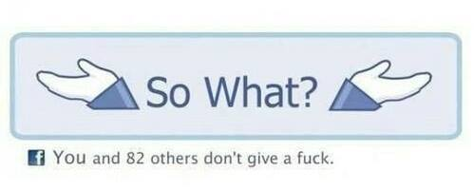

Slide 31
“Mind your own business!
I document my data the way I want!”

Slide 32
“Excel works just fine.
I don’t need any fancy R or Python or whatever.”

Slide 33
“I’d rather do
real science
than tidy up
my data”

Slide 34
“It’s only the result that matters!”

Slide 35
“My field is very competitive
and I can’t risk wasting time”
Notes:
Think of it as putting in the right experimental controls. Can be time consuming but integral part of project.

Slide 36
When do you need to worry about reproducibility?
Before you start the project
While you do the analysis
When you write the paper
When you co-author a paper
When you review a paper
ALWAYS!

Slide 37
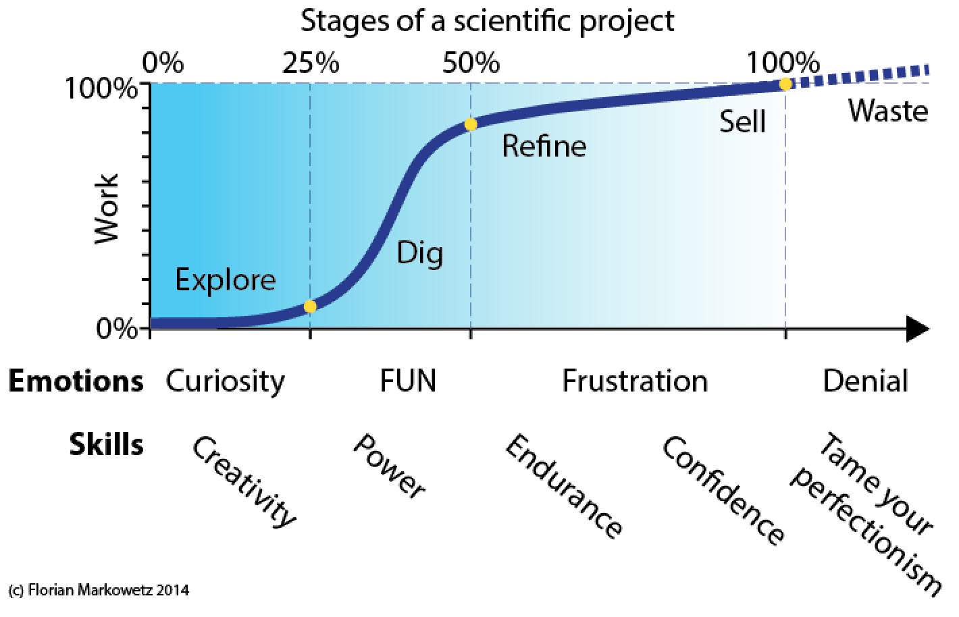
https://scientificbsides.wordpress.com/2014/05/26/methods-vs-insights-4-the-four-stages-of-a-project-and-the-fifth-you-should-avoid/

Slide 38
5 selfish reasons to work reproducibly
Avoid disaster
Easier to write papers
Easier to talk to reviewers
Continuity of your work/in the lab
Standing in the community

Slide 39
Scientific SOFT SKILLS
\project
\data
\code
\analysis
\paper
Organization of project
Tidy data
Tidy code
Control over tools
Documentation
Reproducibility
Less clicking and pasting,
more scripting and coding

Slide 40
Reproducibility is important for
Phd students
Postdocs
PIs
Learn tools and apply in daily work!
Create a ‘culture of reproducibility’ in your lab!

Slide 41
Reproducibility rulez!
Thank you !

